Slide 1
N-body simulation
Esposito Giorgio Angelo (664640) – University of Pisa

Slide 2
TABLE OF CONTENTS
01
N-body problem
02
ODEs solving methods
03
ODEs formulation for the N-body problem
04
Results and conclusions
Definition and history
Euler
Runge-Kutta
Adams- Bashford

Slide 3
01
N-body problem
Definition and history

Slide 4
In physics, the N-body problem is the problem of predicting the individual motions of a group of celestial objects interacting with each other gravitetionally
Notes:
Newton ha definito il problema come conseguenza della nascita delle leggi della gravitazione universale e risolto il problema dei due corpi
Lagrange poi tentò di estendere le soluzioni di Newton per tre corpi, scoprendo soluzioni «particolari»: i punti Lagrangiani
Poincaré dimostra che una soluzione analitica per tre corpi non esiste

Slide 5
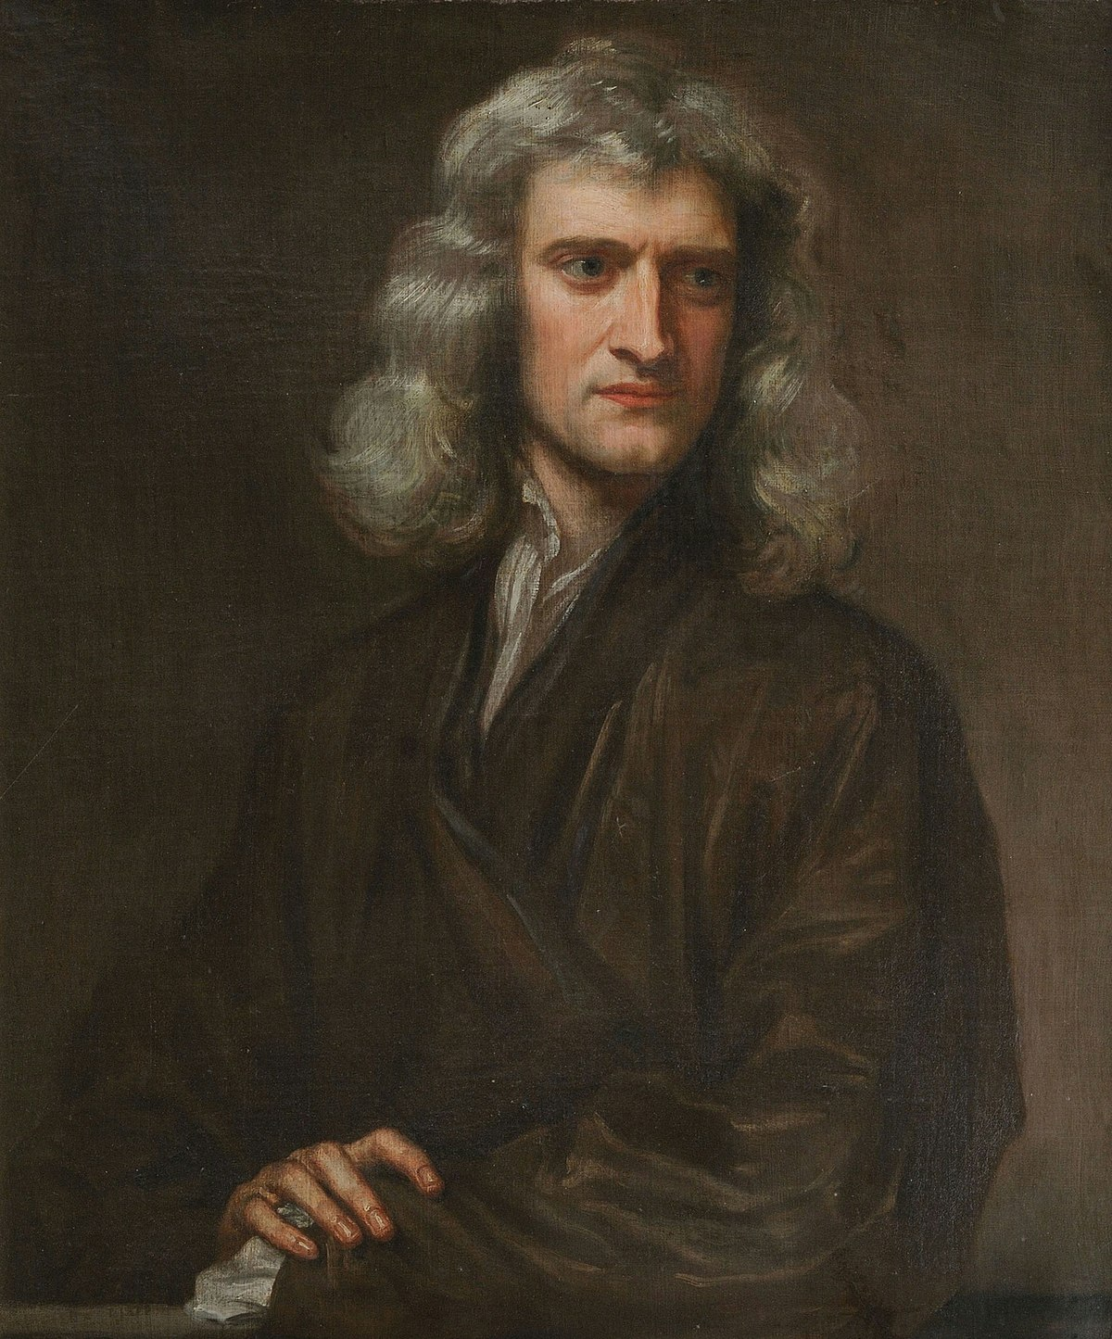
Isaac Newton
His “Laws of Universal Gravitation” where the foundation for the N-body problem.
He was able to solve analytically the two body problems (elliptic, parabolic or hyperbolic motions)

Slide 6
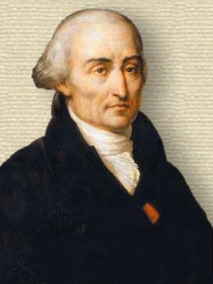
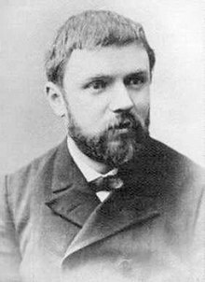
Joseph-Louis Lagrange
Tried to solve the 3 body problem, finding special solutions called Lagrangian points.
Henry Poincaré
Proved that an analytical solution for the 3 body problem do not exists.
Notes:
I punti di Lagrange sono dei punti dove 3 corpi mantengono una configurazione stabile relativa tra di loro

Slide 7
With the advent of computers, numerical methods become the primary tool for solving the N-body problem by running simulations
High Performance Computing (HPC) have allowed more detailed and extensive simulation
Notes:
Usato anche per studiare cluster di stelle, evoluzione di galassie e la struttura dell’universo

Slide 8
02
ODEs solving methods

Slide 9
EULER METHOD

Slide 10



It is based on the idea of discretizing the dynamics of differential equations by time steps of constant length τ
At each step, the solution of the differential equation is approximated by its derivative computed at the beginning of the time interval of length τ
$$\dot{N}=f(N\left(t\right))$$
with
$$N_{0}=N(0)$$
Solution:
$$N_{k+1}=N_{k}+ τf(N_{k})$$

Slide 11
RUNGE-KUTTA (RK) METHODS

Slide 12
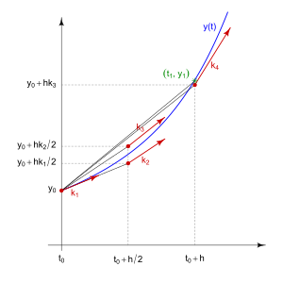




The RK methods are a family of iterative methods.
The solution of an ODE is obtained by taking into consideration multiple slope estimation: each of them provides information about the function’s behavior at different points within the interval, typically at the beginning, in the middle and at end of the interval.
$$\dot{N}=f(N\left(t\right))$$
with
$$N_{0}=N(0)$$
$$N_{i+1}= N_{i}+ τ\sum_{j=1}^{s}{b_{j}k_{j}}$$
$$k_{j}=f(N_{i}+ τ\sum_{l=1}^{j−1}{a_{jl}k_{l}})$$

Slide 13
ADAMS-BASHFORD (AB) METHODS

Slide 14



The AB method is a multistep method. The solution of the ODEs will be obtained by taking into consideration multiple past derivatives.
$$\dot{N}=f(N\left(t\right))$$
with
$$N_{0}=N(0)$$
$$N_{k+1}= N_{k}+ τ\sum_{i=0}^{n−1}{β_{i}f(N_{k−i})}$$

Slide 15
ODEs formulation for the N-body problem
03

Slide 16



Universal law of gravitation
$$F_{i}= \sum_{\begin{aligned}j=1 \\ j≠i\end{aligned}}^{n}{F_{ij}}$$
$$F_{ij}= \frac{m_{i}m_{j}}{r^{2}}$$
Newton’s second law
$$F_{i}= m_{i}a_{i} → a_{i}= \frac{F_{i}}{m_{i}}$$

Slide 17







Euler ODEs
$$a\left(t\right)≈ \frac{v\left(t+ τ\right)−v(t)}{τ}$$
$$v\left(t+ τ\right)=v\left(t\right)+ τa(t)$$
$$→v_{n}= v_{n−1}+ τa_{n}$$
$$v\left(t\right)≈ \frac{p\left(t+ τ\right)−p(t)}{τ}$$
$$p\left(t+ τ\right)=p\left(t\right)+ τv\left(t\right) → p_{n}=$$
$$p_{n−1}+$$
$$τv_{n}$$

Slide 18










RK (4° order) ODEs
Velocity
Position
$$k_{1, v_{i}}= τ v_{i}(t)$$
$$k_{1,p_{i}}= τ p_{i}(t)$$
$$k_{2,v_{i}}= τ (v_{i}\left(t\right)+ \frac{1}{2}k_{1,v_{i}})$$
$$k_{2,p_{i}}= τ (p_{i}\left(t\right)+ \frac{1}{2}k_{1,p_{i}})$$
$$k_{3,v_{i}}= τ (v_{i}\left(t\right)+ \frac{1}{2}k_{2,v_{i}})$$
$$k_{3,p_{i}}= τ (p_{i}\left(t\right)+ \frac{1}{2}k_{2,p_{i}})$$
$$k_{4,v_{i}}= τ (v_{i}\left(t\right)+ k_{3,v_{i}})$$
$$k_{4,p_{i}}= τ (p_{i}\left(t\right)+ k_{3,p_{i}})$$
$$v_{i}\left(t+ τ\right)= v_{i}\left(t\right)+ \frac{1}{6}(k_{1,v_{i}}+2k_{2,v_{i}}+2k_{3,v_{i}}+k_{4,v_{i}})$$
$$p_{i}\left(t+ τ\right)= p_{i}\left(t\right)+ \frac{1}{6}(k_{1,p_{i}}+2k_{2,p_{i}}+2k_{3,p_{i}}+k_{4,p_{i}})$$

Slide 19


AB ODEs
$$v_{k+1}= v_{k}+τ\sum_{i=0}^{n−1}{β_{i}a_{k−i}}$$
$$p_{k+1}= p_{k}+τ\sum_{i=0}^{n−1}{β_{i}v_{k−i}}$$

Slide 20
Psuedocode
1. Initialize position, velocity and acceleration for the bodies
2. While (t < simulation_time):
2.1 For each body:
2.1.1 Compute gravitational forces
2.1.2 Compute acceleration
2.2 For each body:
2.2.1 Update velocity according to the selected method
2.2.2 Update position according to the selected method
2.3 Update t -> t + Δt

Slide 21
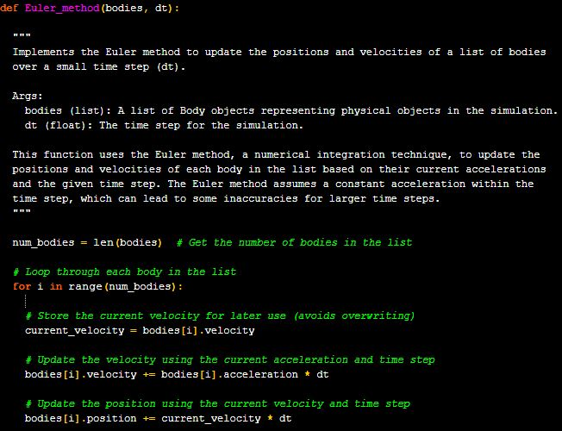
Euler method implmentation

Slide 22
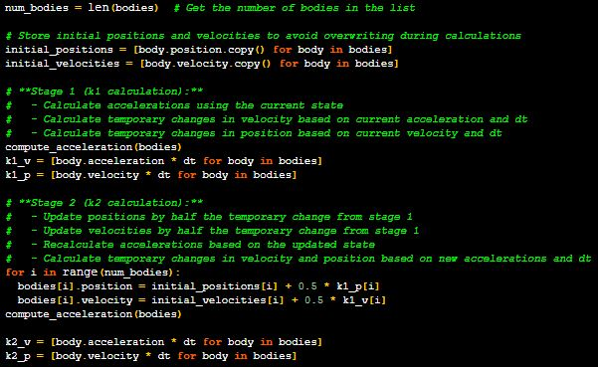
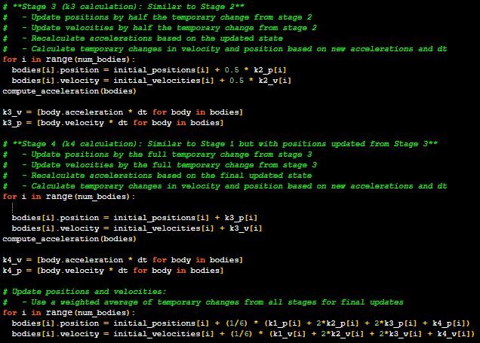
Runge-Kutta method implmentation

Slide 23
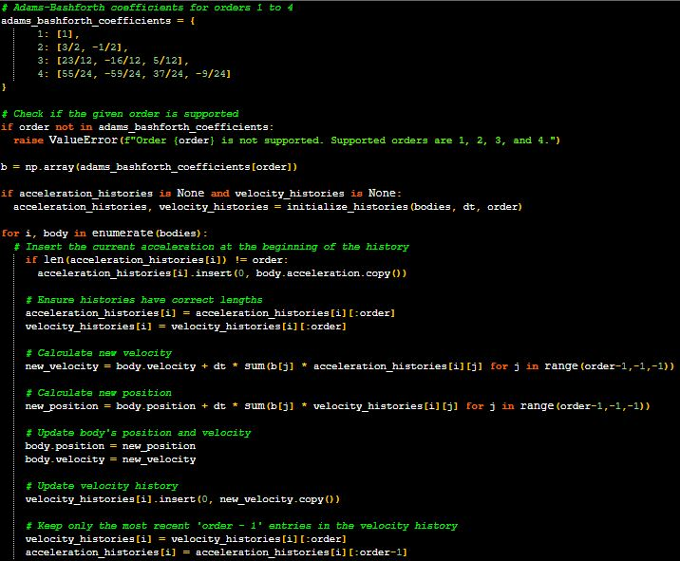
Adams-Bashford method implmentation

Slide 24
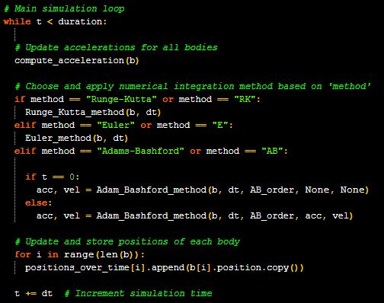
Main simulation

Slide 25
Results and conclusion
04

Slide 26
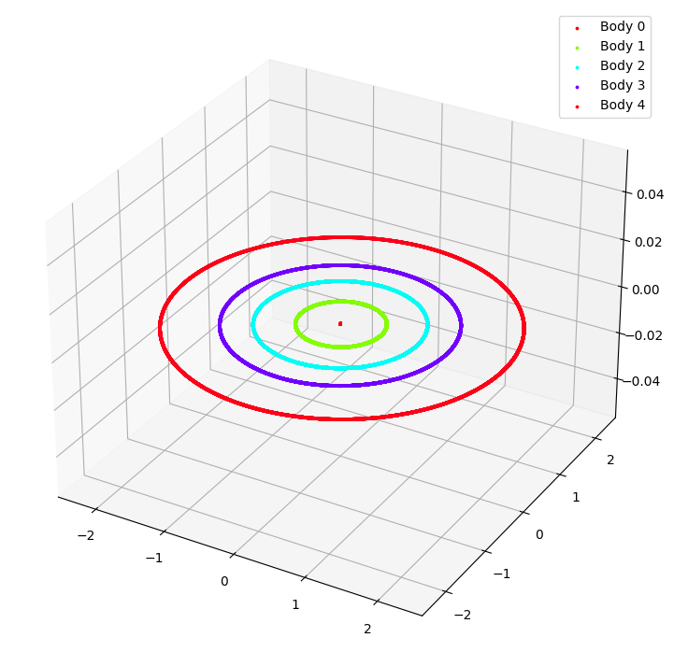
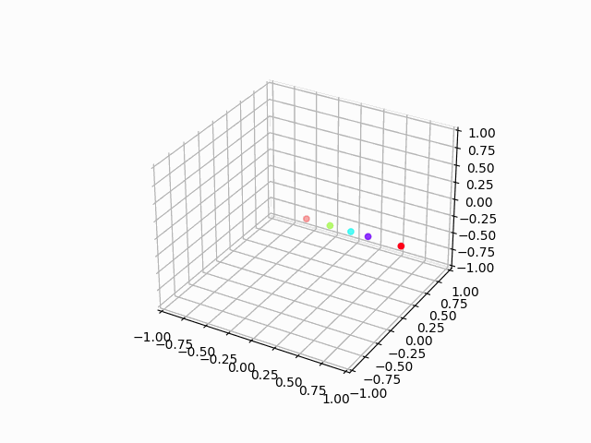
Solar System simulation

Slide 27
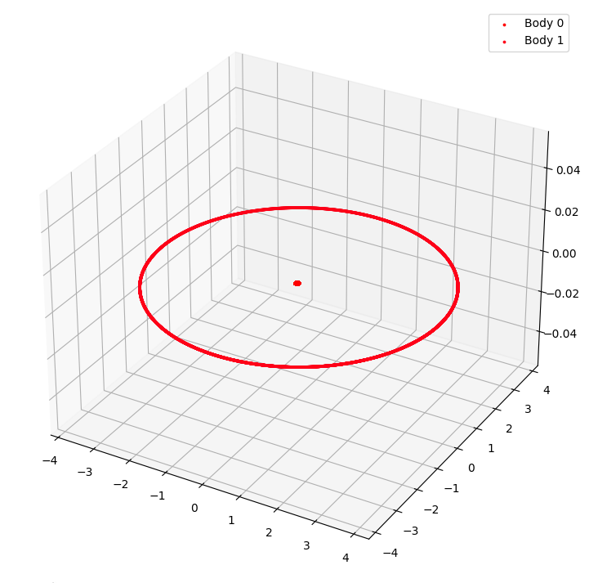
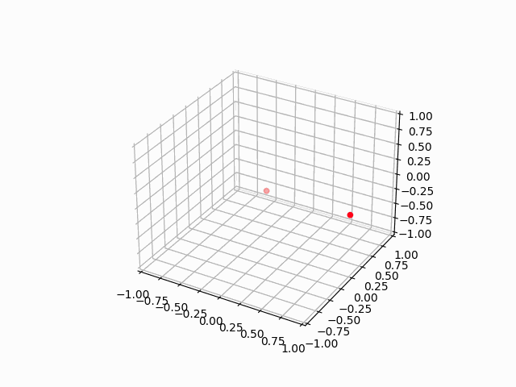
Earth – Moon Simulation

Slide 28
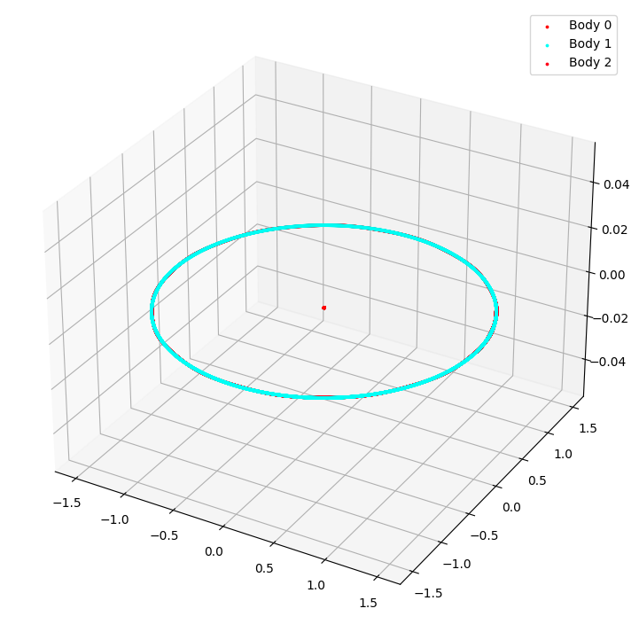

Sun - Earth – Moon Simulation

Slide 29
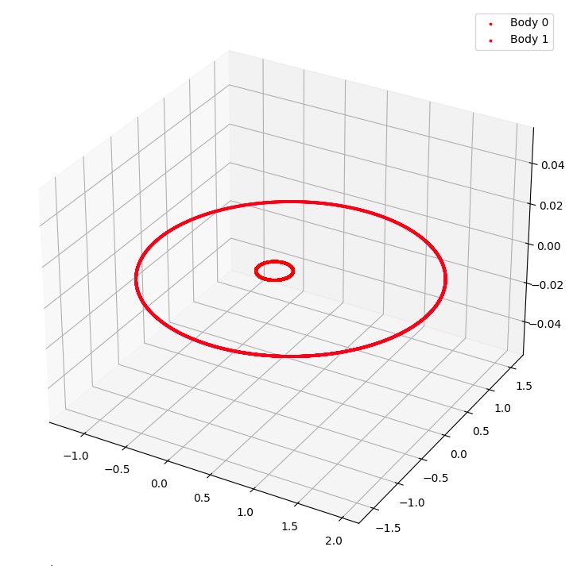

Pluto – Charon simulation

Slide 30
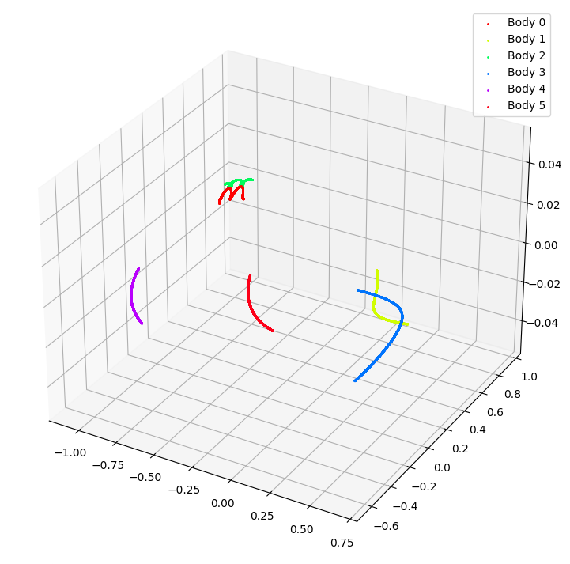
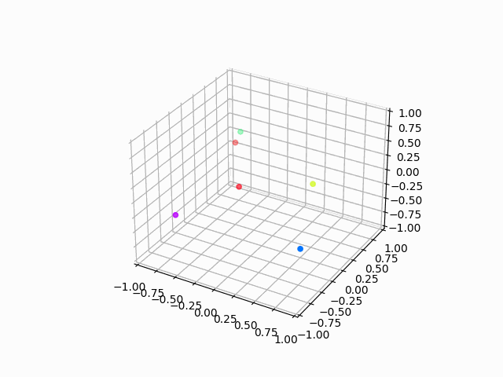
6 random bodies simulation

Slide 31
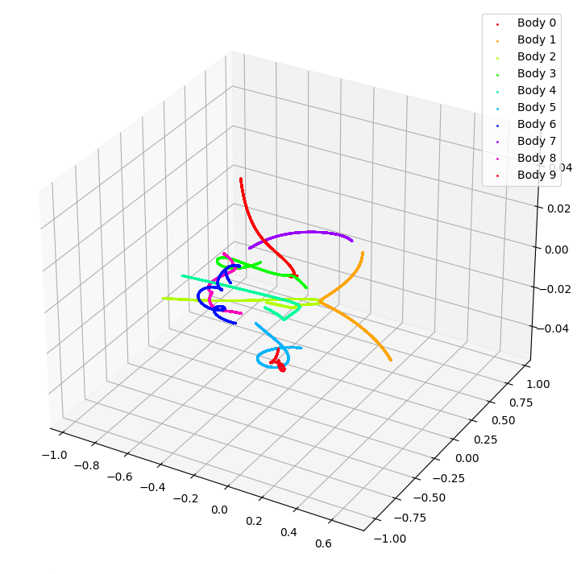
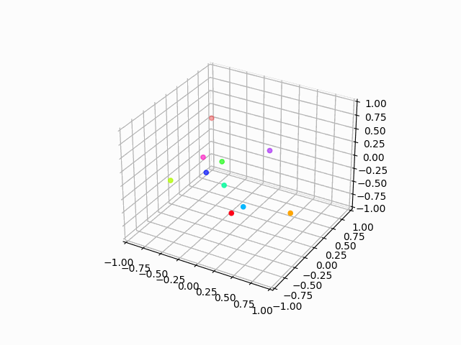
10 random bodies simulation

Slide 32
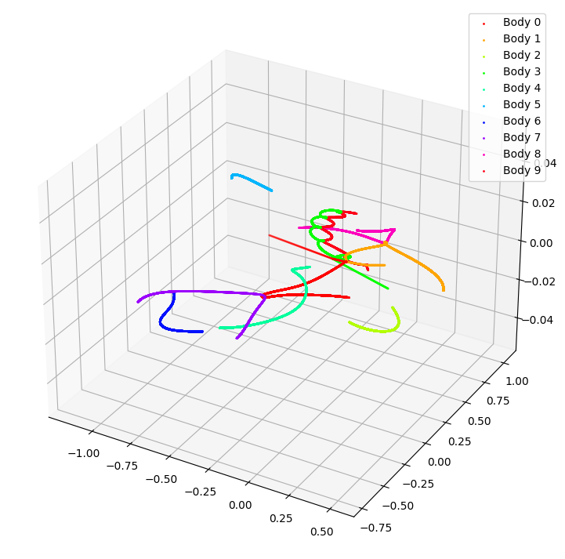
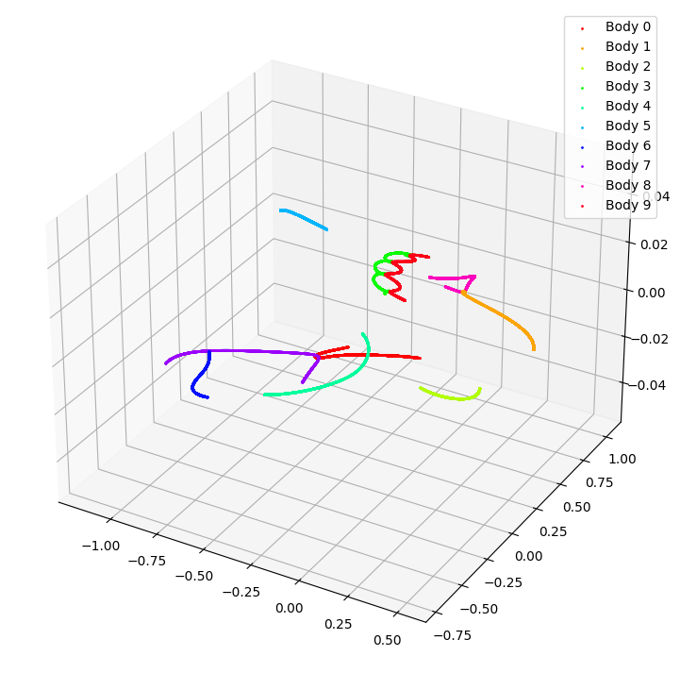
10 random bodies simulation - Method comparison (1)
Notes:
In Euler (sinistra) traiettorie meno accurate e con più errori. RK mantiene l’integrità della simulazione in un periodo più lungo

Slide 33
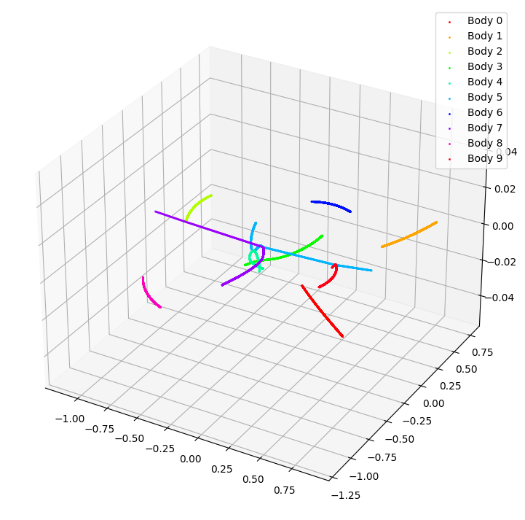
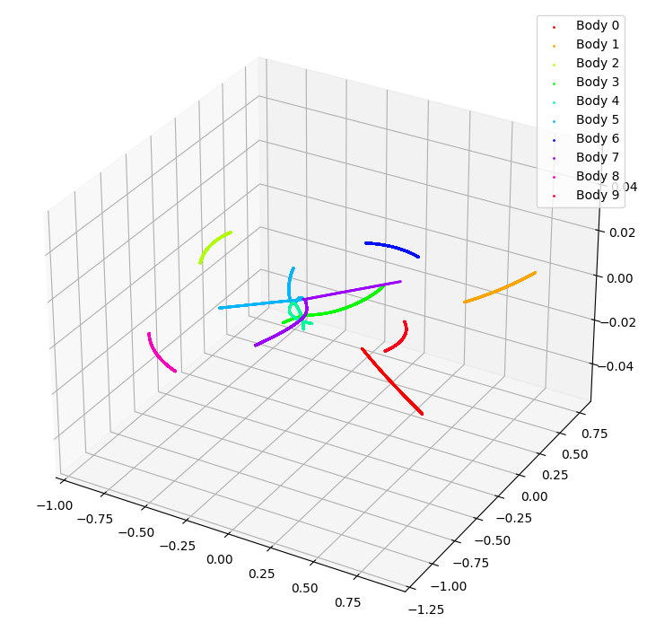
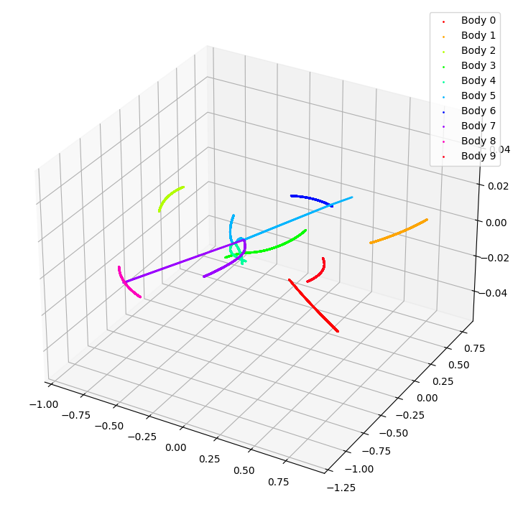
10 random bodies simulation – Method comparison (2)
Notes:
Euler ha traiettorie meno «smooth» rispetto a RK e AB. I corpi LB e DB sembrano avere una traiettoria più accurata in RK e AB rispetto a E, quindi RK e AB sono più stabili rispetto a E

Slide 34
In conclusion, the investigation into the N-body simulation using various numerical methods, (Euler, Runge-Kutta and Adams-Bashford) has showed important insights into respective efficiences and accuracies.
Overall, the selection of a numerical method for the N-bodysimulation should be based on the specific needs of the problem, balancing the trade-offs between accuracy, computational efficiency and stability.
RK is advantegous for high-precision requirement, while AB serves well for scenarios demanding larger timesteps with reasonable accuracy.

Slide 35
THANKS FOR THE ATTENTION! Do you have any question?
GitHub repository link: https://github.com/giorgio-angelo-esposito/N-body-simulation

